Slide 1
Categorie B: Microsoft Office Automation
Xavier Geerinck
Joey Comhaire

Slide 2
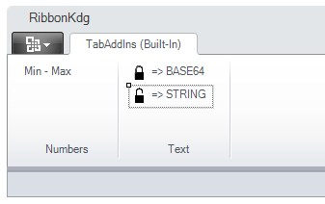
What?
Write personal functions for MS Office
Uses MS office API

Slide 3
API
= Application Programming Interface
Methods to communicate with application
E.g. reference: Microsoft.Office.Interop.Excel

Slide 4
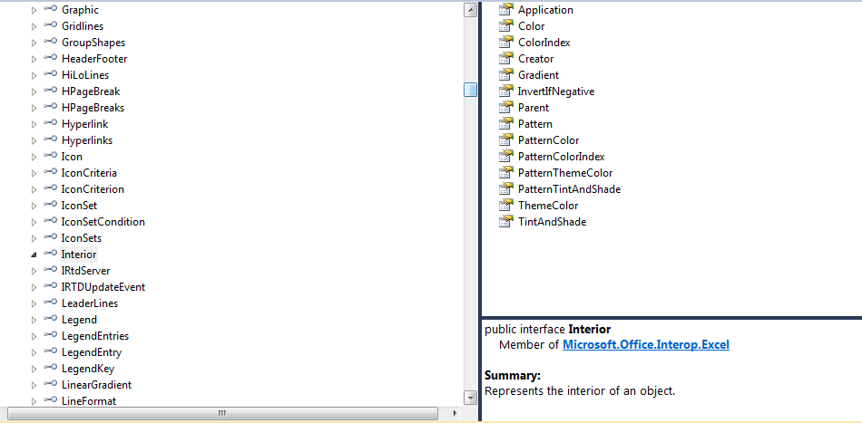

Slide 5
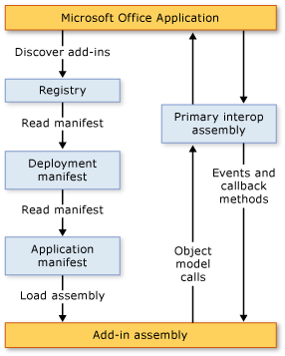
Architecture

Slide 6
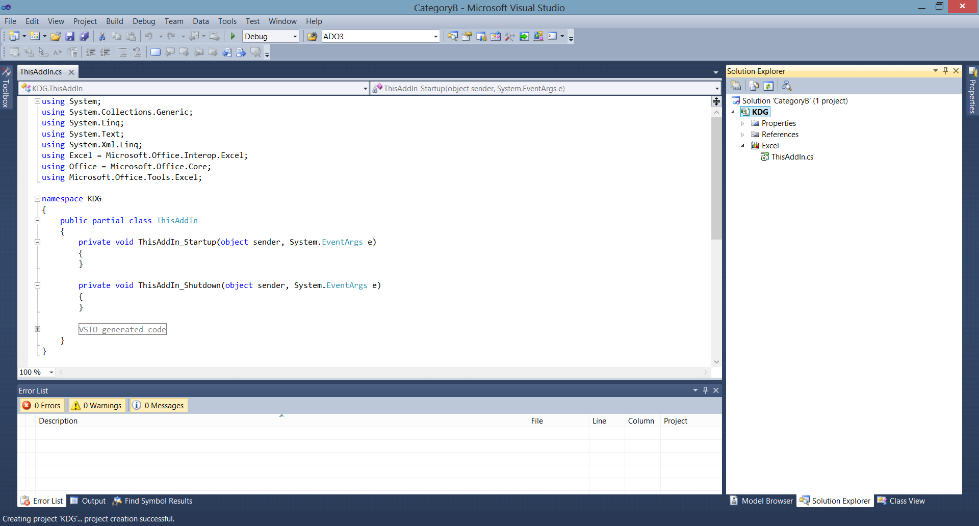
Setting up
New Project ➔ Visual C# ➔ Office ➔ Excel (version) Add-In

Slide 7
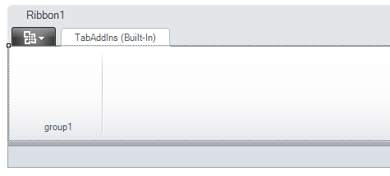
Getting started
Add ➔ new Item ➔ Ribbon Visual Designer

Slide 8
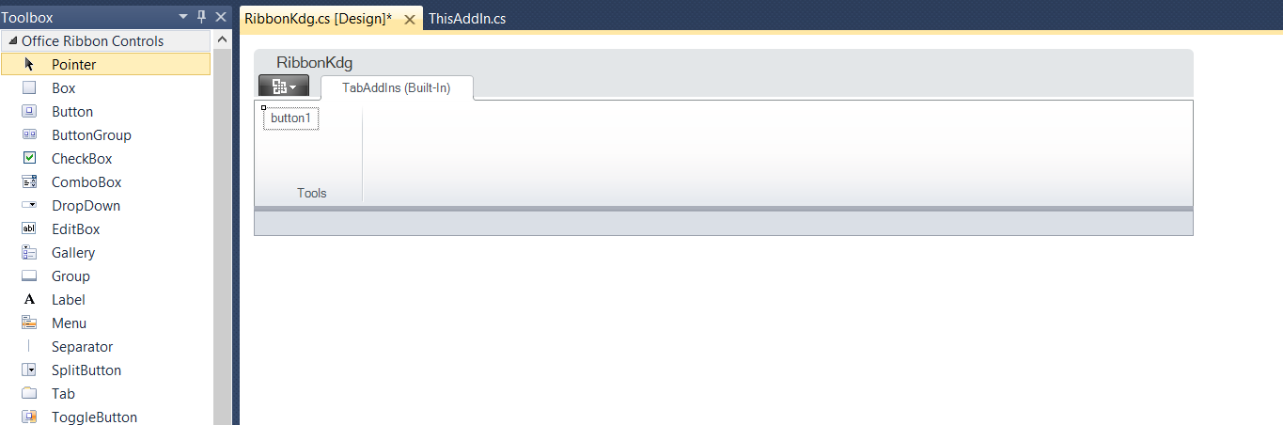
Add buttons

Slide 9
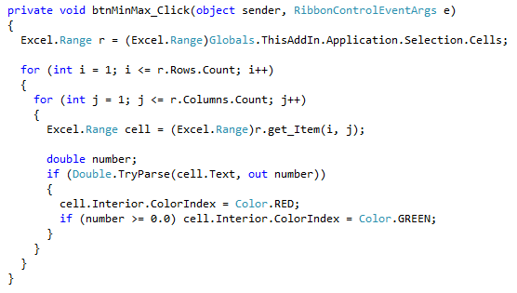
Adding functionality
Double click on button
Fill in the method

Slide 10
Excel API
using Excel = Microsoft.Office.Interop.Excel;
Getting selection = Excel.Range
Looping through selection
Getting separate cell = range.get_Item(row,column);

Slide 11
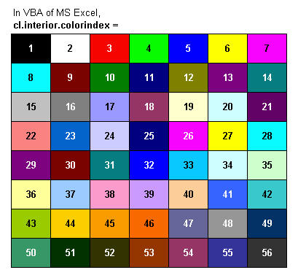
Excel API
Cell.Interior (color ≠ colorIndex)
Cell.text (read-only)
Cell.value2
Range.rows.count
Range.columns.count

Slide 12
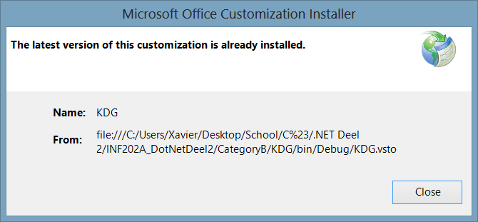
How to use
Build: F6 ➔ Go to project ➔ bin ➔ debug ➔ double click .vsto file,
Vsto = Visual Studio Tools for Office
Start Excel

Slide 13
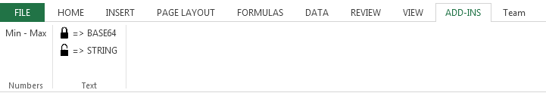
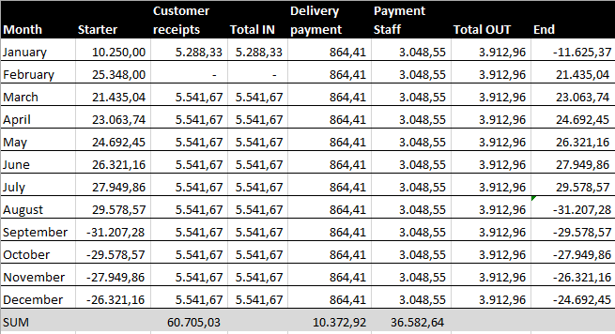
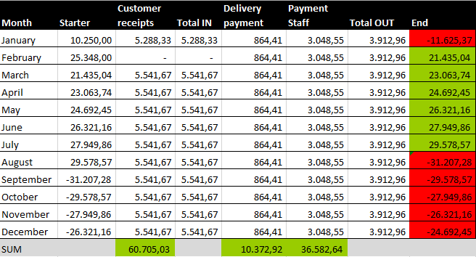
Example

Slide 14
Conclusion

Slide 15
Conclusion
Great custom automation tools
Good API
Visual designer for Ribbons in VS

Slide 16
Sources

Slide 17
Sources
http://msdn.microsoft.com/en-us/library/dd264733.aspx
http://msdn.microsoft.com/en-us/office/hh128771
http://nl.wikipedia.org/wiki/Application_programming_interface
http://msdn.microsoft.com/nl-be/library/bb386298.aspx

